Slide 1
BAFN602 Corporate Finance
Students’ name
Institutional affiliations

Slide 2
Introduction
Corporate finance covers corporate capital and management actions aimed at increasing the company's value.
Notes:
Corporate finance covers corporate capital, including the financing of a corporation, and management actions aimed at increasing the company's value. Corporate finance also includes instruments and analyzes for prioritizing and distributing financial resources. The ultimate goal of corporate finance is to maximize the value of a business, while balancing risk and profitability, by planning and implementing resources.

Slide 3
Question 1 part I
Ethical allegations against IOOF
Informed consent
Beneficence- Do not harm
Respect for anonymity and confidentiality
Skills of the researcher
Notes:
Informed consent
The key moral issue in doing investigate is educated assent. "It implies that an individual gives his assent intentionally, cleverly, willfully, and in a plain and show way," says Armiger.
Beneficence- Do not harm
Beauchamp and Childress have written a new book about their experiences in the public service. The book is called "The Truth Behind The Story" by David Childress.
Respect for anonymity and confidentiality
The rights to advantage, regard for respect, and loyalty are completely interwoven with the subject of classification and obscurity (Taleb, et al, 2021 pp78). At the point when the subject's character can't be connected to individual reactions, as indicated by the ANA, namelessness is shielded.
Skills of the researcher
Nursing researchers should be aware of their own personal limitations, according to the Royal College of Nurses , says Dr Jameton O'Connor. The is a professional body for nurses and midwives in the. Research should be supervised by a coach.

Slide 4
Question 1 part ii
Governance and common good implications
Maurice Clark regretted how business "obtained a monetary issue of lack of quality" from the free endeavor feelings and practices of early industrialism.
He fought for more broad social and money related outcomes which ought to be considered, he said. The conversation continues to the current day.
Notes:
In Australia, the Corporations Act Section 181 obliges chiefs and other corporate officials to practice their forces and release their obligations. Financial backer regard has consistently been connected with short-termism and a negligence of more broad corporate commitments considering a genuine worry for ensured advantage extension.

Slide 5
Question 1 part iii
Lesson learned from Royal Commission
Financial services royal commission had a huge impact on the sector two years ago.
Notes:
Financial services royal commission had a huge impact on the sector two years ago. Reforms resulting from the royal commission on elderly care will be similarly significant. The governance, risk, and compliance duties of aged care boards are likely to be greatly reinforced as a result.

Slide 6
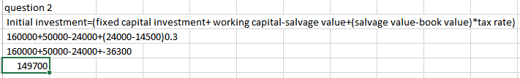
Question 2 part I
Initial investment
Notes:
The initial investment according to the firm is 149700

Slide 7
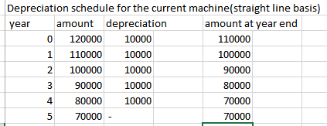
Question 2 part ii
Depreciation schedule for the current machine
Notes:
The depreciation amount for the current machine of the firm in each year is 10000

Slide 8
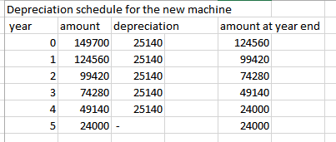
Question 2 part ii
Depreciation schedule for the new machine
Notes:
The depreciation schedule for the new machine in each year is 25140s

Slide 9
Question 2 part iv
Terminal cash flow
terminal cashflows for the project
 |  | year 1 | year 2 | year 3 | year 4 | year 5
EBITDA |  | 105000 | 110000 | 120000 | 120000 | 120000
less depreciation |  | 25140 | 25140 | 25140 | 25140 | 25140
EBIT |  | 79860 | 84860 | 94860 | 94860 | 94860
less interest |  | 2395.8 | 2545.8 | 2845.8 | 2845.8 | 2845.8
earnings before tax |  | 71464.2 | 82314.2 | 92014.2 | 92014.2 | 92014.2
less tax 30% |  | 23239.26 | 24694.26 | 27604.26 | 27604.26 | 27604.26
earnings after tax |  | 54224.94 | 57619.94 | 64409.94 | 64409.94 | 64409.94
terminal value |  | - | - | - | - | 64409.94
terminal value=5th year cashflow(1+g)/ke-0
6440.94(1+0)/0.1-0
644099.4
Notes:
The terminal cash flow is 644099.4

Slide 10
Question 2 part v
Net present value for the both machines
net present value for the current machine
year | cashflows |  | PVF10% | present value
0 | 120000 |  | 1 | 120000
1 | 67505 |  | 0.9091 | 61368.8
2 | 67505 |  | 0.8264 | 55786.13
3 | 67505 |  | 0.7513 | 50716.51
4 | 67505 |  | 0.683 | 46105.92
5 | 67505 |  | 0.6209 | 41913.85
 |  |  | NPV | 135891.2
net present value for the new machine
year | cashflows |  | PVF10% | present value
0 | 160000 |  | 1 | 160000
1 | 78837 |  | 0.9091 | 71670.72
2 | 82232 |  | 0.8264 | 67956.52
3 | 89022 |  | 0.7513 | 66882.23
4 | 89022 |  | 0.683 | 60802.03
5 | 89022 |  | 0.6209 | 55273.76
 |  |  | NPV | 162585.3
internal rate of return(IRR)=LR+NPVHR-0/(HR-LR)
 | 0.08+106290.27/106290.27-149520.47(0.15-0.02)
 | IRR=0.08+-017
 | IRR= -0.09
Notes:
NPV for the current machine is 135891.2
NPV fir the new machine is 162585.3
IRR is -0.09

Slide 11
Question 2 part vi
Recommendation of the firm
Based on the analysis of the net present value of each machine, I would recommend that the firm purchases the new machine
Notes:
The new machine promises a larger NPV of 162585.26 as compared to the NPV of the old machine of 135891.21
However if the operating cash flows were to be considered I would recommend that the firm retains the present machine since it has lower operating cost which are acceptable for any firm.

Slide 12
Conclusion
In question one we have discussed the major ethical allegations against IOOF and also the corporate governance and common good implications of business malpractices allegedly perpetrated by IOOF and also summarized the lessons learned and which are not to be repeated in from experience from the findings of the Royal commission.
Notes:
Based on question 2 we recommend the purchase of the new machine for the firm.

Slide 13
References
Abu-Taleb, M., Rashid, A. and Shams, S., 2021. The Hayne Royal Commission and the financial planning advice: A review of the impact on the operating model of financial advice firms. Financial Planning Research Journal, 6(1), pp.74-85.
O'Connor, B., 2021. False dichotomy: Salary or super-don't fall for it!. Newsmonth, 41(1), p.15.
Hayne, K., 2019. Royal Commission into misconduct in the banking, superannuation and financial services industry. Royal Commission into Misconduct in the Banking, Superannuation and Financial Services Industry.
Knott, A., Retirees’ Financial Choices in Periods of Calm and Crisis: Australian Account Based Pension Evidence.
Weinbren, D., 2021. Fraternal Networks of Victorian Norfolk. Family & Community History, 24(1), pp.24-42.

